Slide 1

Hazards of Environmental Engineering and Ecosystem Structure
Information Security Fundamentals | Introduction to environment and ecosystem
Course: Information Security Fundamentals | Chapter: Introduction to environment and ecosystem | Program: Bachelor of Engineering
DISCOVER · LEARN · EMPOWER
Notes:
Welcome everyone to today's session on the hazards of environmental engineering and the structure of ecosystems. We will explore how human interventions can disrupt natural balances. This lecture is crucial for understanding the risks we face in our engineered environments. Let us begin by mapping our learning outcomes to the course goals.

Slide 2
Course Outcomes
SLIDE 2 / 14
Course Outcome
CO | BT LEVEL | DESCRIPTION
CO1 | BT4 | Recall, analyze and respond on fundamental environmental principles, such as ecological relationships and conservation strategies
CO2 | BT4 | Understand and analyze the interconnections between human activities and environmental impacts across different ecosystems
CO3 | BT4 | Understand and analyze and apply environmental laws and policies to analyse and propose solutions for real-world environmental challenges.
CO4 | BT2 | Students will analyse data from environmental monitoring programs to assess trends and predict future impacts on ecosystems.
CO5 | BT6 | Interpret, elaborate and propose various tools, design and innovative strategies for sustainable development and environmental conservation initiatives in securing the planet.
Chandigarh University
2 / 14
Notes:
Our primary goal for this lecture is to ensure you can recall and analyze fundamental environmental principles. Specifically, we focus on ecological relationships and conservation strategies as outlined in CO1. By the end of this session, you will be able to identify hazards and explain ecosystem functions clearly. This outcome is the foundation for all future engineering safety assessments.

Slide 3
Learning Objectives
SLIDE 3 / 14
Learning Outcomes
1
Analyze the specific hazards arising from environmental engineering projects.
2
Evaluate the structural components of a functional ecosystem.
3
Differentiate between natural and engineered ecosystem functions.
4
Assess the impact of engineering failures on ecological stability.
5
Apply analytical skills to identify conservation strategies for hazards.
Chandigarh University
3 / 14
Notes:
By the end of this lecture, you will be able to analyze specific hazards from engineering projects. You will also evaluate the structural components that make an ecosystem function correctly. We will differentiate between natural processes and those altered by human engineering. Finally, you will apply these analytical skills to identify real-world conservation strategies.

Slide 4
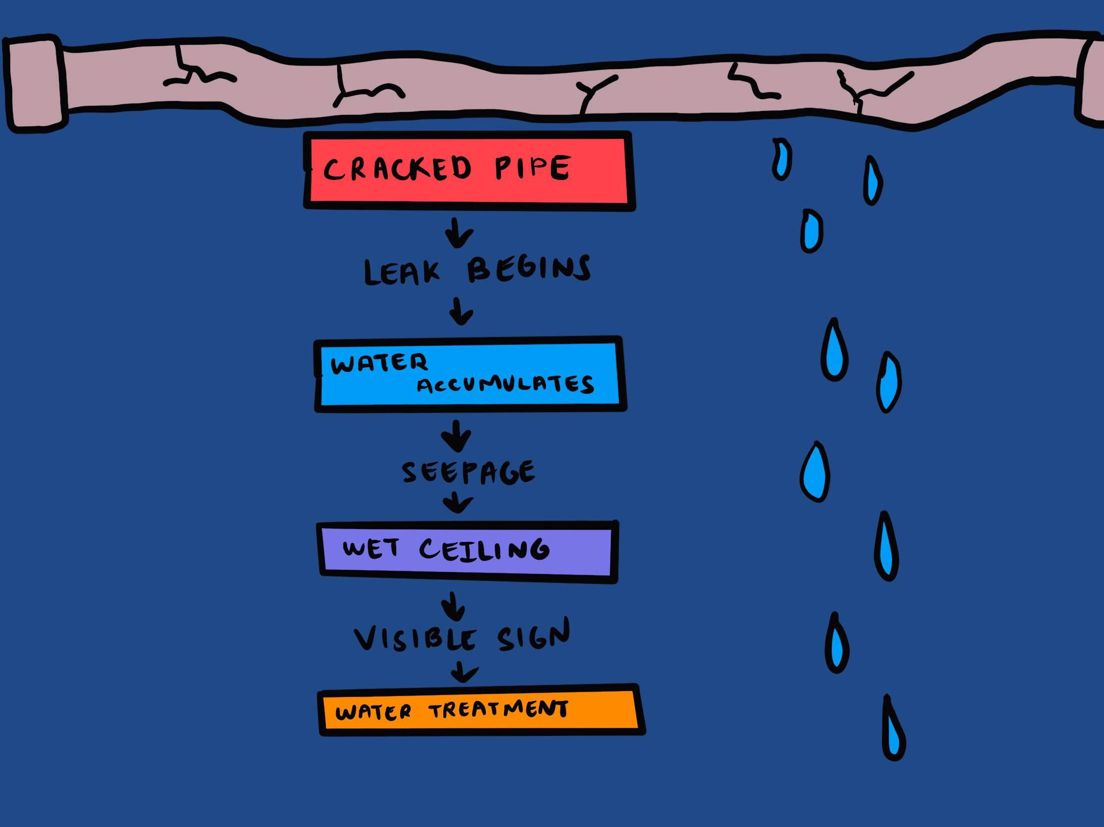
Lecture
SLIDE 4 / 14
Defining Hazards in Environmental Engineering
1
Hazards are potential sources of harm to human health or the environment.
2
Environmental engineering hazards include chemical spills, noise pollution, and structural failures.
3
These hazards often arise from the unintended consequences of infrastructure development.
4
A hazard becomes a risk when combined with the probability of exposure.
5
Understanding the source is the first step in mitigating environmental engineering risks.
6
Common sources include wastewater treatment plants, landfills, and industrial effluents.
7
Engineering controls are designed to eliminate or reduce these identified hazards.
Root Cause Analysis - The Decision Lab
Chandigarh University
4 / 14
Notes:
Let us define what we mean by hazards in this context. A hazard is any potential source of harm, such as a chemical spill or structural failure. These often arise from the unintended consequences of our infrastructure development projects. For example, a poorly designed landfill liner can lead to groundwater contamination. Recognizing the source is the critical first step in any mitigation strategy.

Slide 5
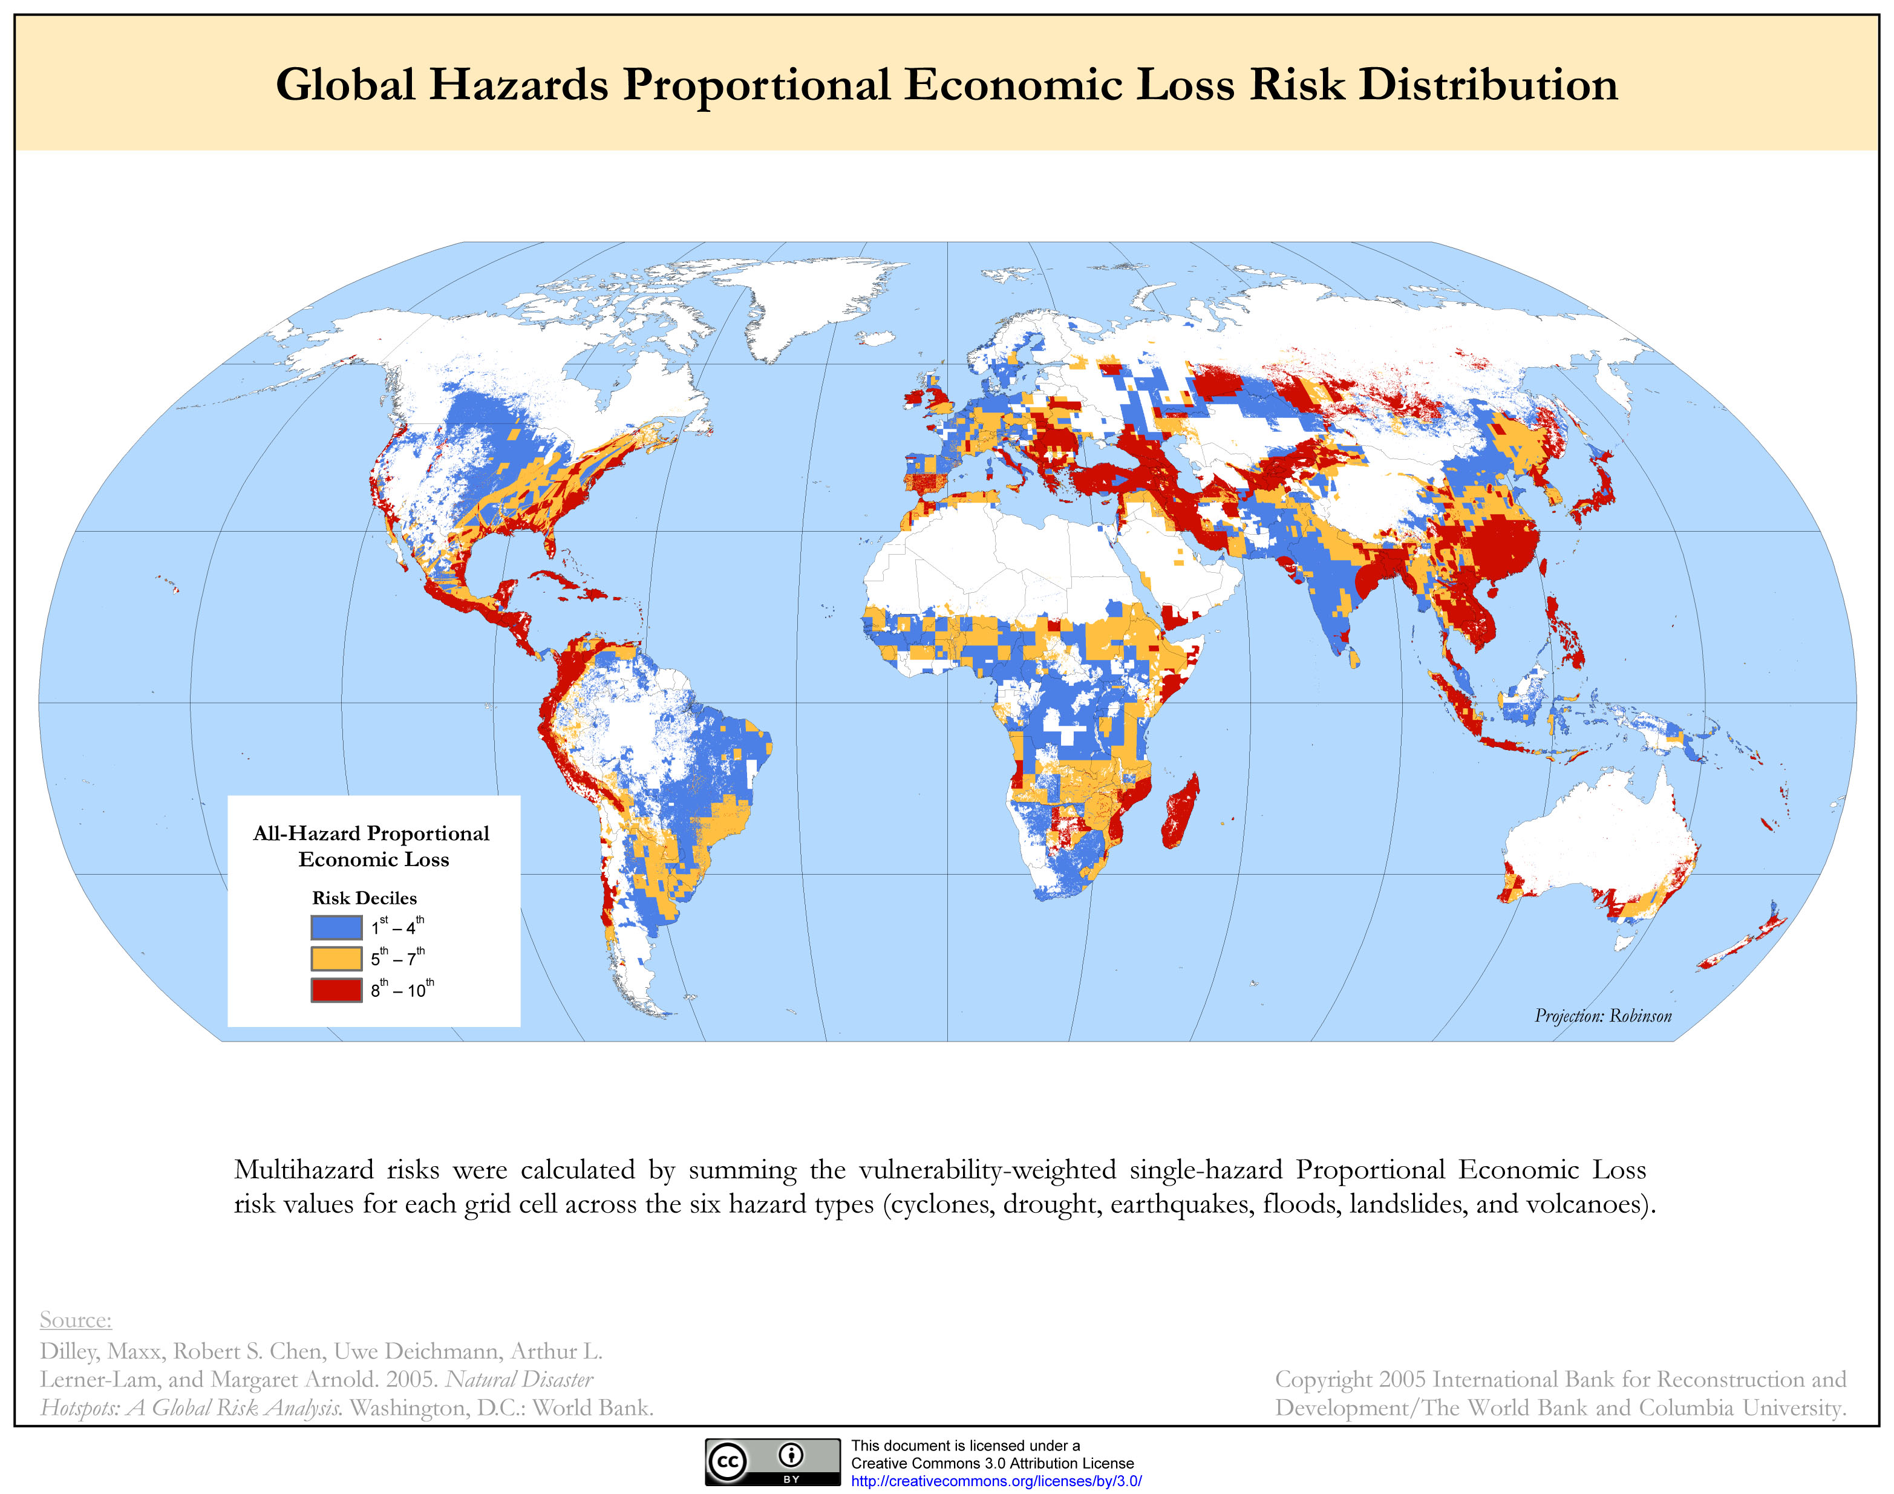
Lecture
SLIDE 5 / 14
Structure of a Natural Ecosystem
1
An ecosystem consists of biotic (living) and abiotic (non-living) components.
2
Biotic components include producers, consumers, and decomposers in a food web.
3
Abiotic components include sunlight, water, soil, temperature, and atmospheric gases.
4
The structure defines the physical arrangement and spatial distribution of these components.
5
Trophic levels organize organisms based on their feeding relationships and energy flow.
6
Biodiversity within the structure ensures resilience against environmental disturbances.
7
Physical structure determines the habitat availability for various species.
Natural disaster (source: Wikipedia — Natural disaster (CC BY-SA))
Chandigarh University
5 / 14
Notes:
The structure of a natural ecosystem is defined by its biotic and abiotic components. Biotic components include producers, consumers, and decomposers that form a complex food web. Abiotic components like sunlight, water, and soil provide the necessary physical conditions. The trophic levels organize these organisms based on their feeding relationships. This physical structure determines the habitat availability for various species within the environment.

Slide 6

Function of Ecosystems
SLIDE 6 / 14
Energy Flow
1
Energy flows through an ecosystem in a one-way direction from the sun.
2
Producers convert solar energy into chemical energy via photosynthesis.
3
Energy transfer between trophic levels follows the 10% law of efficiency.
4
Approximately 90% of energy is lost as heat at each transfer step.
5
This unidirectional flow drives all biological processes and metabolic activities.
6
Detritus food chains recycle nutrients while consuming dead organic matter.
7
Energy flow is the primary function that sustains life within the system.
Plastic (source: Wikipedia — Plastic (CC BY-SA))
Chandigarh University
6 / 14
Notes:
Energy flows through an ecosystem in a one-way direction, starting from the sun. Producers convert this solar energy into chemical energy through the process of photosynthesis. The transfer between trophic levels follows the 10% law, where only a fraction is passed on. Approximately 90% of energy is lost as heat at each transfer step. This unidirectional flow is the primary function that sustains all life within the system.

Slide 7
Function of Ecosystems
SLIDE 7 / 14
Nutrient Cycling
1
Nutrients cycle continuously between biotic and abiotic components of the ecosystem.
2
Key cycles include carbon, nitrogen, phosphorus, and water cycles.
3
Decomposers break down dead matter to release nutrients back into the soil.
4
Nutrient cycling ensures the sustainability of life without external inputs.
5
Human activities can disrupt these cycles, leading to pollution or scarcity.
6
Biogeochemical cycles connect biological processes with geological and chemical processes.
7
Disruption in cycling leads to accumulation of toxins or depletion of resources.
Plastic (source: Wikipedia — Plastic (CC BY-SA))
Chandigarh University
7 / 14
Notes:
While energy flows one way, nutrients cycle continuously between living and non-living components. Key cycles include the carbon, nitrogen, and phosphorus cycles that sustain life. Decomposers play a vital role by breaking down dead matter to release nutrients back into the soil. Human activities can disrupt these cycles, leading to severe pollution or resource scarcity. Biogeochemical cycles connect biological processes with geological and chemical processes to maintain balance.

Slide 8
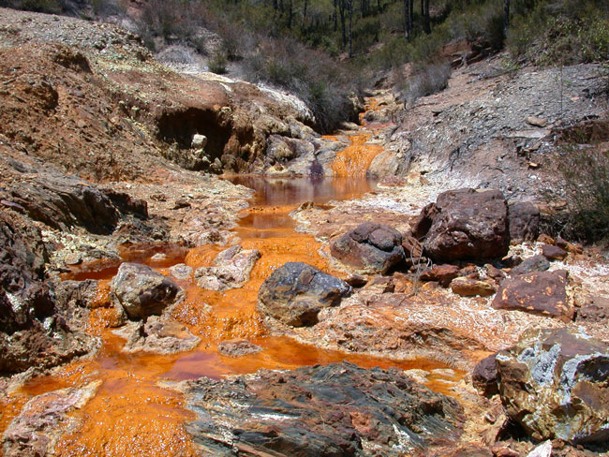
Hazards
SLIDE 8 / 14
Disruption of Ecosystem Structure
1
Engineering projects often fragment habitats, isolating populations of species.
2
Deforestation for infrastructure removes the structural base of the ecosystem.
3
Pollution alters abiotic factors like water pH and soil composition.
4
Invasive species introduced by human activity disrupt native structural balance.
5
Loss of keystone species can cause a collapse of the entire structure.
6
Physical barriers like dams block migration routes and alter flow dynamics.
7
Structural degradation reduces the ecosystem's ability to support biodiversity.
Environmental impact of mining (source: Wikipedia — Environmental impact of mining (CC BY-SA))
Chandigarh University
8 / 14
Notes:
Engineering projects often fragment habitats, effectively isolating populations of species from one another. Deforestation for infrastructure removes the structural base that supports the entire ecosystem. Pollution alters critical abiotic factors like water pH and soil composition, making them uninhabitable. Invasive species introduced by human activity can disrupt the native structural balance. The loss of keystone species can cause a collapse of the entire structure.

Slide 9
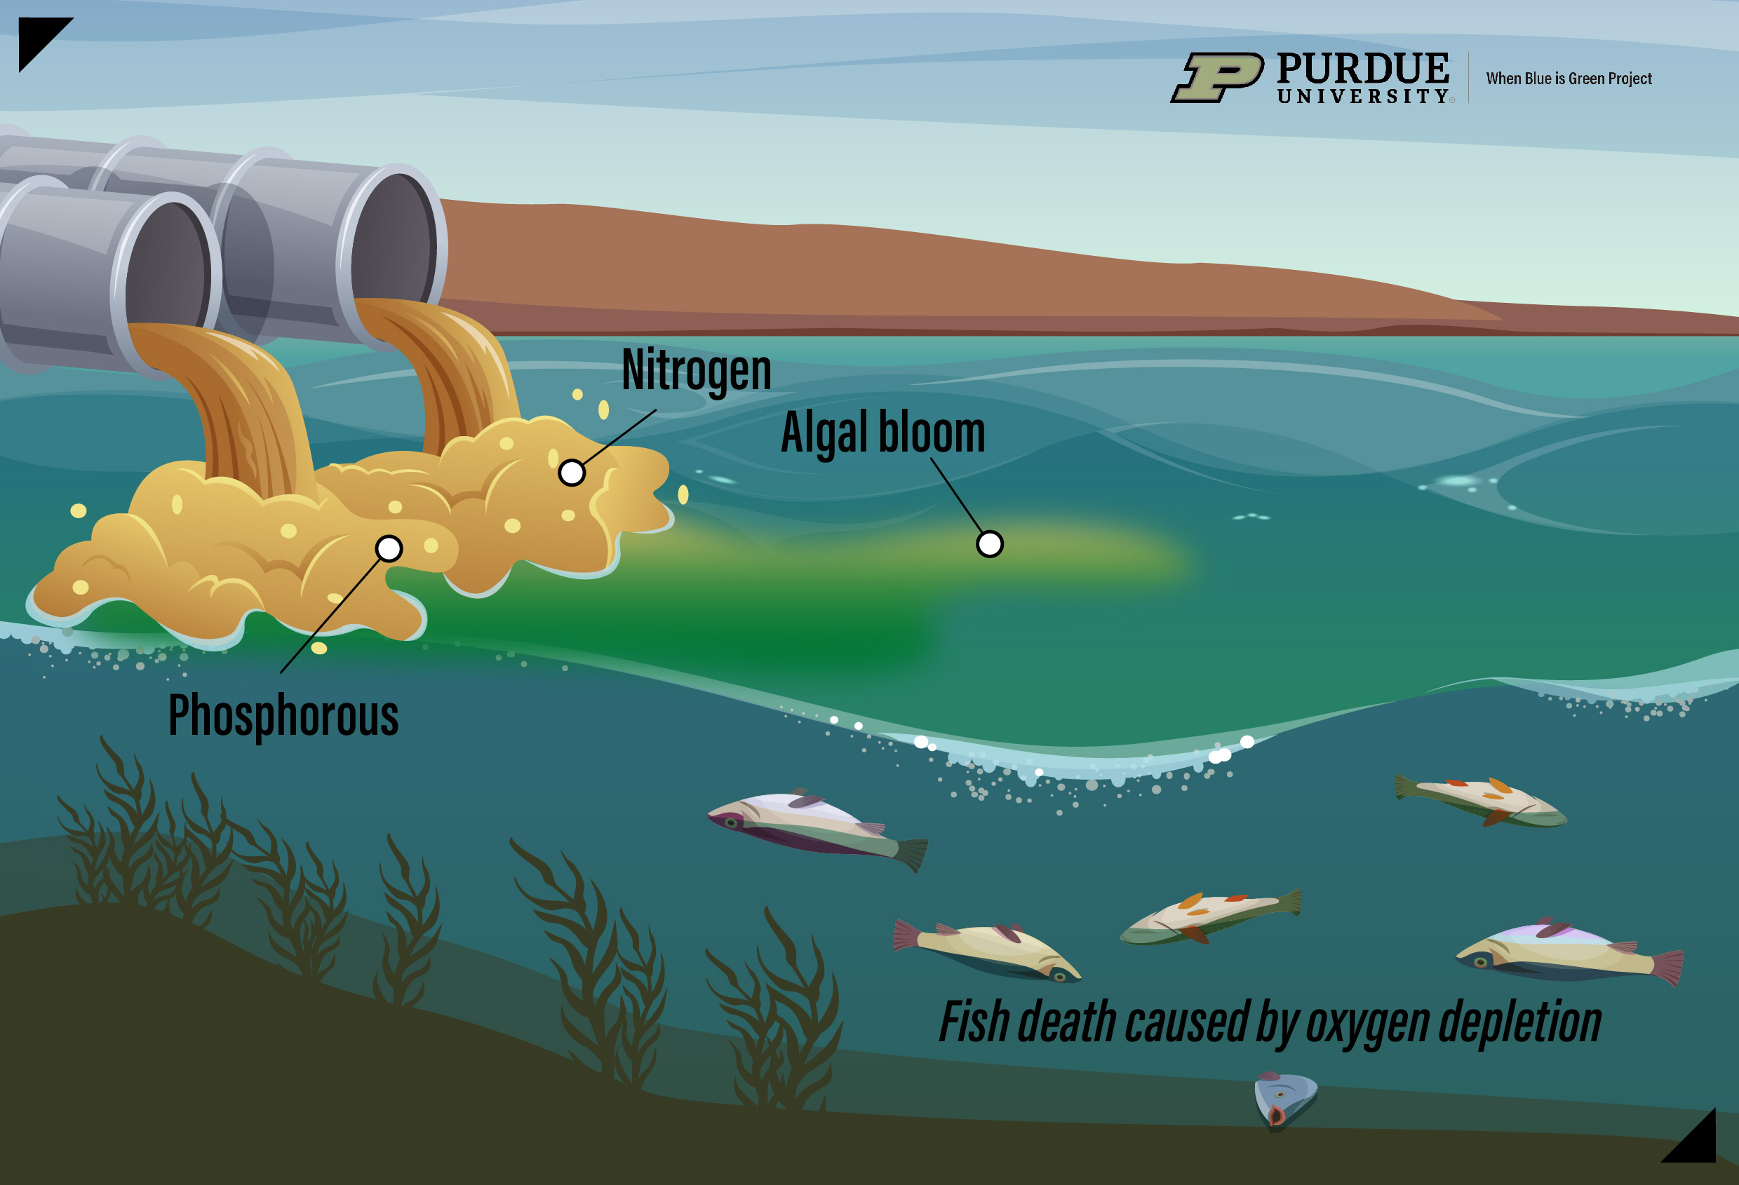
Hazards
SLIDE 9 / 14
Disruption of Ecosystem Function
1
Pollution can block energy flow by killing primary producers like algae.
2
Chemical runoff disrupts nutrient cycling by altering decomposition rates.
3
Eutrophication causes oxygen depletion, halting aerobic biological functions.
4
Acid rain disrupts nutrient cycling by leaching essential minerals from soil.
5
Noise pollution interferes with animal communication and reproductive functions.
6
Thermal pollution reduces dissolved oxygen, affecting aquatic metabolic functions.
7
Functional disruption leads to a loss of ecosystem services for humans.
Source: ag.purdue.edu
Chandigarh University
9 / 14
Notes:
Pollution can block energy flow by killing primary producers like algae in water bodies. Chemical runoff disrupts nutrient cycling by altering the rates of decomposition. Eutrophication causes oxygen depletion, which halts aerobic biological functions essential for life. Acid rain disrupts nutrient cycling by leaching essential minerals from the soil. Noise pollution interferes with animal communication and reproductive functions, affecting population stability.

Slide 10
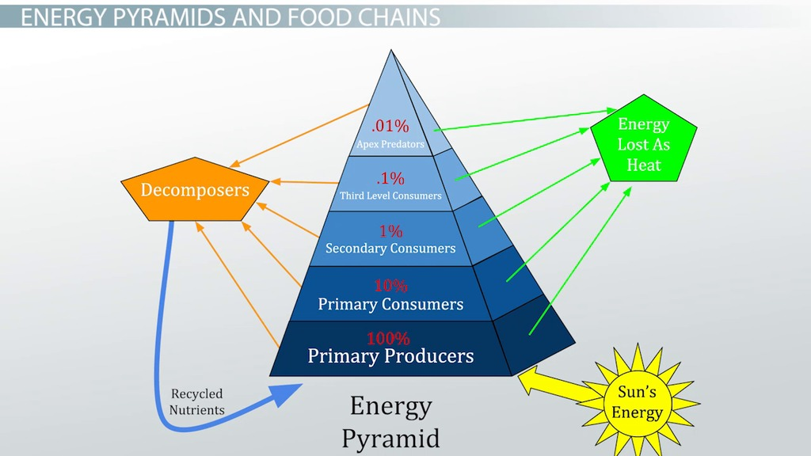
Worked Example
SLIDE 10 / 14
Energy Loss Calculation
GOVERNING EQUATION
Primary consumers receive 10% of producer energy = 1,000 J
SCENARIO
A plant captures 10,000 J of solar energy.
CALCULATION
Energy_available = Initial_Energy × (0.1)^n where n is level.
• Producers convert this to 10,000 J of chemical energy.
• Secondary consumers receive 10% of primary energy = 100 J.
• Tertiary consumers receive 10% of secondary energy = 10 J.
• This demonstrates why food chains rarely exceed four or five levels.
Source: study.com
Chandigarh University
10 / 14
Notes:
Let us calculate the energy loss in a food chain. If a plant captures 10,000 Joules of solar energy, it converts this to chemical energy. Primary consumers receive only 10% of that, which is 1,000 Joules. Secondary consumers then receive 10% of that, which is 100 Joules. Tertiary consumers receive just 10 Joules. This calculation demonstrates why food chains rarely exceed four or five levels due to energy loss.

Slide 11

Lecture
SLIDE 11 / 14
Common Pitfalls in Hazard Analysis
1
Confusing a hazard with a risk leads to incorrect safety protocols.
2
Ignoring cumulative effects of multiple small hazards causes underestimation.
3
Assuming linear relationships in complex ecosystems leads to prediction errors.
4
Overlooking indirect effects like trophic cascades in impact assessments.
5
Focusing only on immediate impacts rather than long-term degradation.
6
Neglecting the role of decomposers in nutrient cycle disruption.
7
Treating engineered systems as isolated from natural ecosystem functions.
Source: cdn.flowchartai.org
Chandigarh University
11 / 14
Notes:
A common pitfall is confusing a hazard with a risk, which leads to incorrect safety protocols. Ignoring cumulative effects of multiple small hazards causes a significant underestimation of total impact. We must avoid assuming linear relationships in complex ecosystems, as this leads to prediction errors. Overlooking indirect effects like trophic cascades is another frequent mistake in impact assessments. We must focus on long-term degradation rather than just immediate impacts.

Slide 12
Lecture
SLIDE 12 / 14
Mitigation Strategies for Engineering Hazards
1
Implementing green infrastructure to restore natural ecosystem functions.
2
Using eco-friendly materials to reduce toxicity in construction projects.
3
Designing wildlife corridors to maintain structural connectivity for species.
4
Applying strict effluent treatment standards to protect water quality.
5
Conducting Environmental Impact Assessments before project initiation.
6
Monitoring ecosystem health indicators to detect early signs of failure.
7
Restoring degraded areas through reforestation and soil remediation.
Chandigarh University
12 / 14
Notes:
We can mitigate these hazards by implementing green infrastructure to restore natural ecosystem functions. Using eco-friendly materials reduces toxicity in construction projects significantly. Designing wildlife corridors maintains structural connectivity for species migration. Applying strict effluent treatment standards is essential to protect water quality. Conducting Environmental Impact Assessments before project initiation helps identify potential risks early.

Slide 13
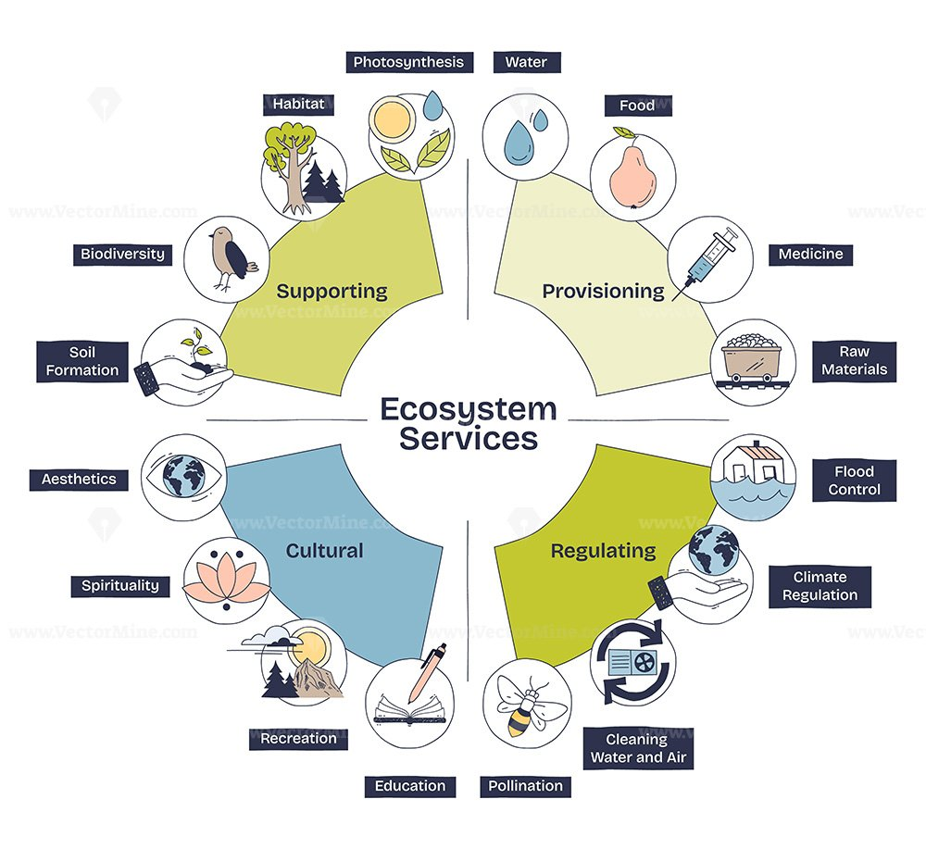
Lecture
SLIDE 13 / 14
Key Takeaways
1
Environmental engineering hazards threaten both human health and ecological stability.
2
Ecosystem structure relies on the balance of biotic and abiotic components.
3
Energy flows unidirectionally while nutrients cycle continuously within systems.
4
Engineering failures disrupt energy flow and nutrient cycling functions.
5
Analysis must consider cumulative effects and indirect trophic interactions.
6
Mitigation requires restoring natural functions through sustainable engineering practices.
Source: bunny-wp-pullzone-lcnorhfy96.b-cdn.net
Chandigarh University
13 / 14
Notes:
To summarize, environmental engineering hazards threaten both human health and ecological stability. Ecosystem structure relies on the delicate balance of biotic and abiotic components. Energy flows unidirectionally while nutrients cycle continuously within these systems. Engineering failures disrupt these critical functions of energy flow and nutrient cycling. Analysis must consider cumulative effects and indirect trophic interactions to be effective.

Slide 14
Lecture
SLIDE 14 / 14
References
ENVIRONMENTAL STUDIES
From Crisis to Cure — R. Rajagopalan
• Environmental Science and Engineering — Benny Joseph
• Environmental Studies — R.C. Sharma and D. Gurbir Sangha
• Introduction to Environmental Science — Anjaneyulu, Y.
• Environmental Pollution Control Engineering — C.S. Rao
• Textbook of Environmental Studies for undergraduate courses — E. Bharucha
• Environmental Science — S.C. Santra
Chandigarh University
14 / 14
Notes:
These references provide the foundational knowledge for the concepts discussed today. Benny Joseph and R.C. Sharma offer detailed insights into environmental principles. Anjaneyulu and C.S. Rao provide specific technical details on pollution control. Please consult these texts for deeper understanding of ecosystem functions and hazards.

